Slide 1
Understanding Global Customer Sentiment Using AI
A Multilingual Twitter Sentiment Analysis Project
Presented by:
Samiksha Kodgire, Chyavan Shenoy & Manoj Nair

Slide 2
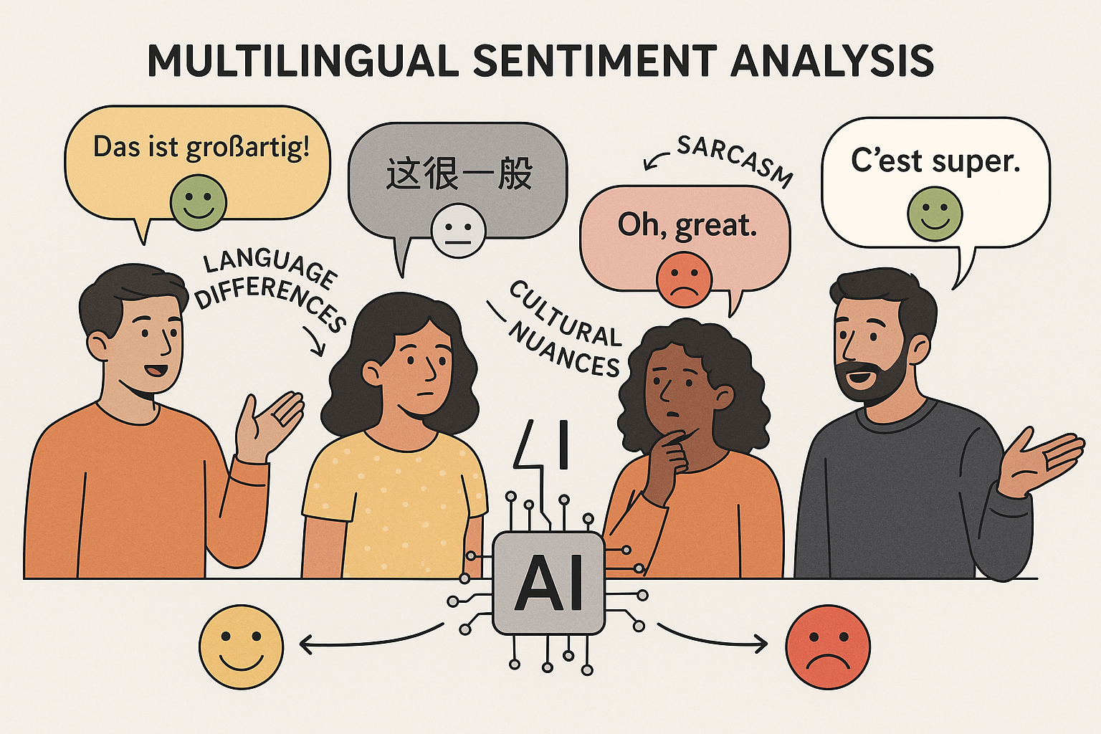
Premising Problem Statement
In today’s globally connected digital world, Twitter acts as a real-time reflection of public sentiment—from political concerns to product opinions.
However, much of this content is shared in regional languages, using informal or code-mixed text that traditional English-centric sentiment tools often misinterpret.
This creates a critical gap for:
• Government agencies looking to detect early signs of unrest, misinformation, or civic issues
• Brands seeking to localize marketing and respond to feedback in culturally relevant ways.

Slide 3
Our Goal
To build a system that decodes public opinion across languages, enabling governments to act faster and brands to connect better with their audiences.
Our solution:Build a robust AI solution to classify sentiment (Positive or Negative).
Cover three key languages: English, French, and Portuguese.
Keep the solution lightweight, scalable, and explainable.
We have built an AI-driven solution to analyze sentiment in English, French, and Portuguese tweets.
Our model achieves up to 82% accuracy across languages.
Ready for real-world deployment in marketing, brand monitoring, and customer experience
Models used include:
Logistic Regression (Baseline)
Random Forest (Ensemble)
LSTM (Sequential Context)
BERT & XLM-RoBERTa(QLoRA). (Multilingual Transformers)
Our main focus: Generalizability, Interpretability, Context Handling

Slide 4
Data Collection & Characteristics
Selected 3 common most spoken language tweets datasets from kaggle:
🇬🇧 English: 100k+ samples with text and sentiment
🇫🇷 French: ~9 lakh samples, but lacks "neutral"
🇵🇹 Portuguese: ~6 lakh samples
Challenges:
Label format inconsistencies (e.g., 0/1/2, strings)
Extra columns
Missing/imbalanced classes
Code-mixed text
Informal styles, langs and language detection issues

Slide 5
Preprocessing and Exploratory Data Analysis (EDA)
Text Cleaning Pipeline:
Remove URLs, mentions, hashtags, punctuation
Lowercase text, normalize whitespace
Filter non-text/corrupted entries
EDA:
Post-cleaning columns: text, label, text_length, word_count, ~195K entries
Sentiment Balance: ~50% Positive / ~50% Negative, dropping neutral
Insights:
Word clouds reveal common terms by sentiment
Text length distribution varies widely
Strong presence of informal and code-mixed pattern

Slide 6
Our Approach
Step-by-step journey:
Curated and cleaned 650K+ tweets across 3 languages (English, French and Portuguese)
Downsampled to balanced datasets of 195K tweets.
Trained and compared five models:
Lightweight BERT
XLM Roberta
LSTM
Logistic regression
Random Forest
Evaluated using accuracy and consistency across languages.

Slide 7
Key Models Compared
Model | Accuracy | Precision | Recall | F1-Score | Pros | Cons
Lightweight BERT | 0.842 | 0.842 | 0.842 | 0.842 | Best accuracy, multilingual, scalable | Slightly heavier than LSTM
Logistic Regression | 0.825 | 0.825 | 0.825 | 0.825 | Lightweight, fast to train | Lower accuracy, not deep NLP
LSTM (Deep Learning) | 0.822 | 0.822 | 0.822 | 0.822 | Interpretable, fast inference | No pretrained language understanding
XLM-RoBERTa (QLoRA) | 0.822 | 0.822 | 0.822 | 0.821 | Multilingual, transformer-based | Slower, more resource heavy
Random Forest | 0.815 | 0.815 | 0.815 | 0.815 | Quick to implement | Not suitable for text-based language inference

Slide 8
Real World Testing
We tested the model on real tweets:
“I love this product, it works perfectly!” → Positive
“Worst experience ever. Totally disappointed.” → Negative
“Ce produit est incroyable, je l'adore!” → Positive
“Très mauvaise qualité, je suis déçu.” → Negativ
✅ Observation
The model correctly identified sentiment across languages and expressions.
Performed well with real-world text inputs including emojis and informal phrasing.
⚠️ Improvement Area
Slight inconsistency in sarcasm and edge cases.
Opportunity to enhance multilingual nuance through additional fine-tuning.

Slide 9
Final recommendation
Lightweight BERT strikes the best balance of accuracy, multilingual performance, and real-world feasibility. It is pretrained, multilingual, and lightweight enough to deploy in most cloud or on-device environments.
Why Lightweight BERT?
Highest F1-score: 0.842
Handles English, French, Portuguese effectively
Pretrained on multilingual data = less training cost
Easily integrated with cloud APIs or mobile apps

Slide 10
Risk Considerations
Category | Risk | Mitigation
Bias | Model may reflect biases of Twitter users | Regular retraining, diverse data
Ethics | Mislabeling emotionally sensitive content | Human-in-the-loop validation for edge cases
Language | Misinterpretation due to sarcasm, slang, or code-mixing | Expand training with localized language examples
Privacy | Use of tweet metadata (e.g., location, username) | Strip personally identifiable info (PII), comply with Twitter’s Terms of Service

Slide 11
Next Steps
Phase 1: Deploy the Sentiment Model
Launch the selected model (Lightweight BERT) into production.
Enable real-time monitoring of customer sentiment across English, French, and Portuguese tweets.
Phase 2: Build a Sentiment Intelligence Dashboard
Visualize customer emotions by region and language.
Share actionable insights with Marketing, CX, and Brand teams.
Phase 3: Expand to Additional Languages
Prepare for scale by incorporating more regional languages (e.g., Hindi, Spanish).
Supports global expansion and localized engagement strategies.
Phase 4: Establish Feedback Loop
Capture edge cases and incorrect predictions to improve accuracy over time.
Include human review where needed to ensure model quality.

Slide 12

Thank you!
Link to GitHub Repo: https://github.com/TheOctoMizer/AAI-510-Project

